Slide 1
CDS-1 PROJECT ASSIGNMENT - IABAC
Employee Perfomance Analysis for INX Future Inc.
By
Felisha Mong’ina Onsombi for

Slide 2
TABLE OF CONTENT
PROJECT SUMMARY
REQUIREMENT
PROBLEM STATEMENT
PROJECT METHODOLOGY
DEPARTMENT WISE PERFOMANCES
MACHINE LEARNING MODELS
IMPORTANT FEATURES
RECOMMENDATIONS

Slide 3
PROJECT SUMMARY
The project is set to analyse the employee perfomance in INX Future Inc, which is a data analytics and automation solution provider.For the past 5 years, the company is rated among the best 20 employees.
However, recently the company has seen the employee performance indexes are not healthy and this is becoming a growing concern among the top management. There has been increased escalations on service delivery and client satisfaction levels came down by 8 percentage points.
The CEO decided to initiate a data science project , which aims to analyse the employee perfomance. The following goals and insights are expected from the project :
Department wise performances
Top 3 Important Factors affecting employee performance
A trained model which can predict the employee performance based on factors as inputs. This will be used to hire employees
Recommendations to improve the employee performance based on insights from analysis.

Slide 4
Numerical Columns | Age , Distance From Home, EmpEucationLevel ,EmpEnvironmentSatisfaction, EmpHourlyRate, EmpJobInvolvement , EmpJobInvolvement, EmpJobLevel, EmpJobSatisfaction, NumCompaniesWorked, EmpLastSalaryHikePercent , EmpRelationshipSatisfaction, TotalWorkExperienceInYears, TrainingTimesLastYear EmpWorkLifeBalance, ExperienceYearsAtThisCompany, ExperienceYearsInCurrentRole YearsSinceLastPromotion, YearsWithCurrent Manager, PerformanceRating
Categorical Columns | Gender, EducationBackground, MaritalStatus, EmpDepartment, EmpJobRole ,BusinessTravelFrequency, OverTime,Attrition
The dataset has 28 columns and 1200 rows, 19 columns being numerical while the other 9 are categorical in nature.
The dataset contains no missing nor duplicate values.
The Dataset went through univariate and bivariate analysis to get more understanding on the data. Visualisations through histograms,pie charts and histoplots and coorelation analysis. Analysis per department by perfomance rating to satisfy the second goal.
The Target variable in this case will be the Perfomance Rating. We encode the data using the label encoder then scale it.
The Machine Learning Model used in this project is Logistic Regression(Model accuracy:80%), Random Classifier(Model accuracy of 91%) and Decision Tree Classifier(Model accuracy of 87%)
One of the goals of this project is to find the important feature affecting the performance rating. The important features were predicted using the machine learning model(Random Forest Classifier) feature importance technique.

Slide 5
REQUIREMENT
The data was obtained from IABAC from the following link:
http://data.iabac.org/exam/p2/data/INX_Future_Inc_Employee_Performance_CDS_Project2_Data_V1.8.xls
The whole project was done in Jupiter notebook with python platform.

Slide 6
PROBLEM STATEMENT
PROBLEM STATEMENT
The aim of this project is to predict the employee performance based on factors as inputs
OBJECTIVES
Department wise performances
Top 3 Important Factors effecting employee performance
Recommendations to improve the employee performance based on insights from analysis.

Slide 7
METHODOLOGY OF THE PROJECT
DATA
DATA PREPROCESSING
DATA ANALYSIS -Univariate Analysis Bivariate Analysis
EVALUATION
FIT THE MACHINE LEARNING MODEL
SEPARATE THE TARGET AND FEATURES

Slide 8
DEPARTMENT WISE PERFOMANCE
SALES DEPARTMENT
The Performace rating level 3 (High) is more in the sales department.
The male employees in the sales departmnent have a performance rating that is little bit higher compared to female.
Divorced have a rating of 3 while the married and single have a less rating.
The total work experience does not count the performance rating.
HUMAN RESOURCES DEPARTMENT
Most employees employees have a level 3 performance.
The older people are performing low in this department.
The female employees in HR department doing really well in their performance.
The total work experience does matter to performance in this department.
DEVELOPMENT DEPARTMENT
The largest number of employees are level 3 performers.
Managers have the highest rating of 3
The gender-based performance is nearly same for both.
RESEARCH AND DEVELOPMENT DEPARTMENT
The largest number of employees are level 3 performers.
Managers have the highest rating while Health Care Rep have the lowest rating.
The gender-based performance is nearly same for both.
The marital status does not matter in this department.
FINANCE DEPARTMENT
Male employees have a higher rating than their female counterparts.
Most employees have a rating of 3.
DATA SCIENCE DEPARTMENT
The highest average of level 3 performance is in data science department.
Business Analyst in the department have highest rating
The overall performance is higher compared to all departments.
Male employees are doing good in this department.

Slide 9
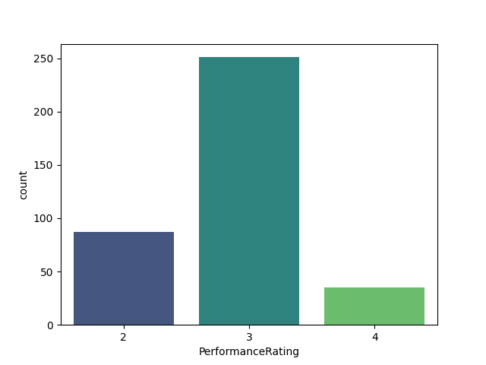
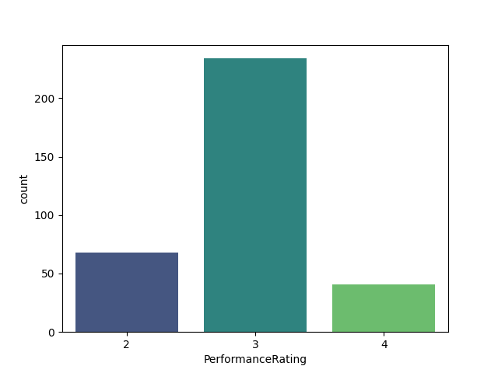
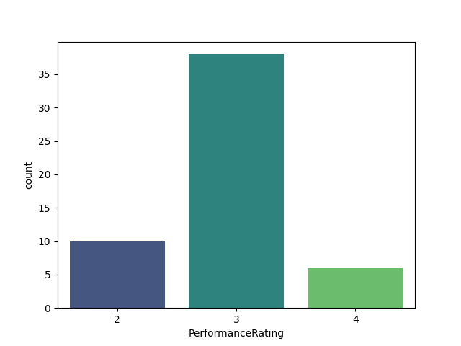
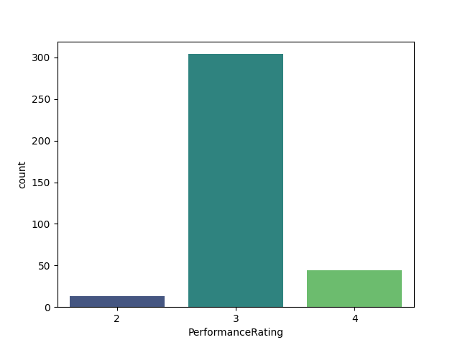
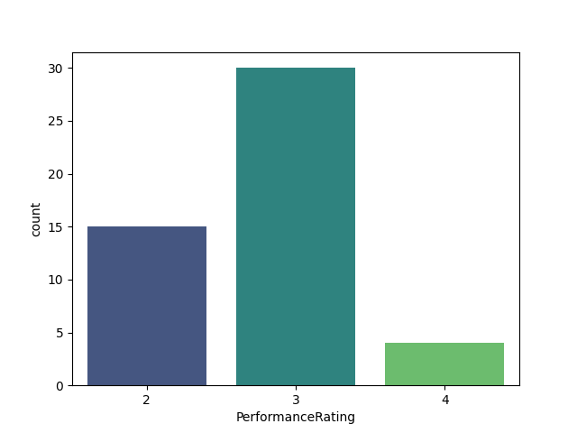
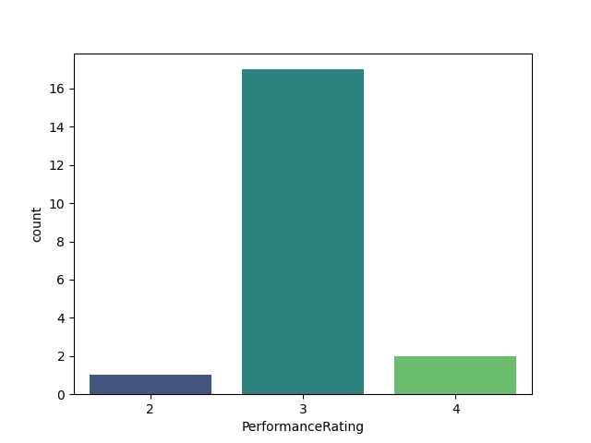
Employee Perfomance in Human resource Department
Employee Perfomance Rate in Research and Development Department
Employee Perfomance Rate in Sales Department
Employee Perfomance Rating in Development Department
Employee Perfomance in Finance Department
Employee Perfomance Rating in Data Science

Slide 10
Machine Learning Model
The Machine Learing Model used were as follows:
Decision Tree Classifier(87%)
Random Forest Classifier(91%)
Random Forest Classifier had the highest accuracy score(91%) therefore best suited therefore suitable for training and developing the model

Slide 11
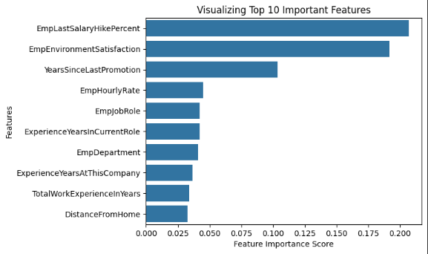
IMPORTANT FEATURES
The Random Forest classifier in Sklearn contains a feature importances attribute which tells us which features within our dataset has been given most importance. The top three important features affecting the performance rating are as follows:
Employee Salary Hike Percentage
Employee Environment Satisfaction
Years Since the last Promotion

Slide 12
RECOMMENDATIONS
The recommendations are as follows:
To increase the employee salary hike percentage, salary hike will boost the employees morale thus increasing perfomance
The company needs to focus on the environment satisfaction, give the employees a proper environment that they are comfortable in and are feeling positive.
Promotion will help the employees to achieve more performance by giving the chance to be more responsible and acquire leadership qualities.
Employee's work-life balance affects the performance rating. Therefore encourage and train employees on how to achieve proper work life balance to enhance employee’s perfomance in the company

Slide 13
THANK YOU!

